Slide 1
Lending club Case study – Elangathir g

Slide 2
Objective
Deciphering the Data
Data Cleansing
Data Analysis
Recommendations based on analysis
Summary

Slide 3
Objective
The objective is to analyze historical data collected on over 100 parameters to derive observations, insights, findings, correlations, and actionable recommendations for Lending Club. The goal is to enhance the loan approval process, ensuring that prospective loan accounts are assessed in a way that minimizes default risk, improves portfolio performance, and optimizes decision-making for better financial outcomes.

Slide 4
Deciphering the Data
Deciphering the historical data involves a analysis of various borrower attributes, loan characteristics, and payment behaviors across a large dataset. By examining over 100 parameters, such as loan amount, interest rates, employment history, income levels, credit utilization, and debt-to-income ratios, we target uncovering patterns and trends that influence loan default risk.

Slide 5
Data Cleansing
Data cleansing and handling involve identifying and addressing issues like missing values, outliers, and inconsistencies in the dataset to ensure accurate and reliable analysis. This process typically includes:
Handling Missing Data: Imputing missing values through methods such as mean/median imputation for numerical columns or mode imputation for categorical columns were discussed. In most cases, rows with excessive missing data are removed.
Outlier Detection: Identifying and handling outliers using statistical methods to prevent them from distorting analysis results.
Data Transformation: Converting categorical variables to numerical forms and normalizing or scaling
Dealing with Duplicates: Removing duplicate entries to maintain the integrity of the dataset.
This thorough approach ensured that the dataset is clean, accurate, and ready for meaningful analysis, minimizing the risk of erroneous insights or conclusions.

Slide 6
Data analysis
Exploratory Data Analysis (EDA) was conducted using the following approaches:
Segmented Univariate Analysis: Breaking down individual variables based on key segments or groups (e.g., loan status, income brackets) to identify patterns or differences that might not be apparent in the overall data.
Bivariate Analysis: Analyzing the relationships between pairs of variables to uncover correlations, dependencies, and trends. This includes using scatter plots, correlation matrices, and other relevant visualizations to examine interactions between key variables.
Recommendations was derived based on the insights gathered from the above analyses.

Slide 7
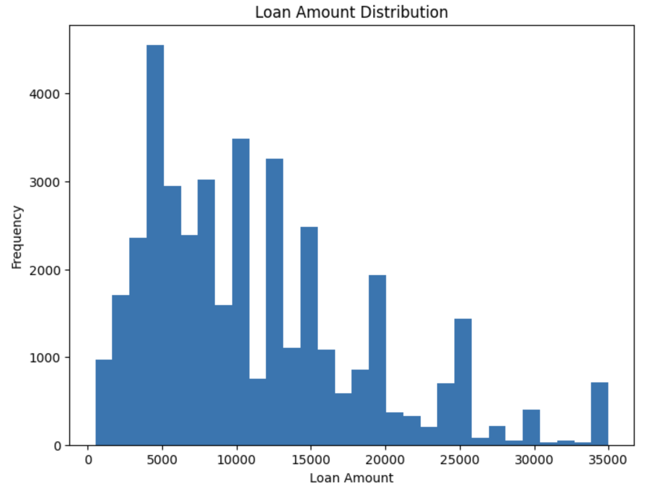
The frequency of the Loan amount ticket from low to high is plotted
We can directly say the maximum loan amount/per ticket is in the range of $5,000 to $10,000
Loan Amount Frequency

Slide 8
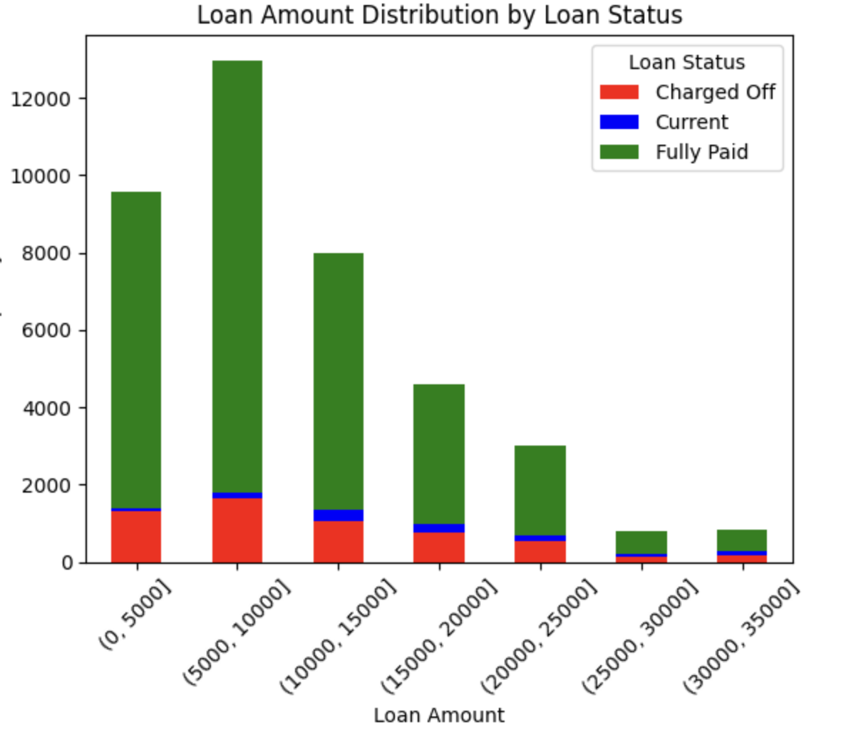
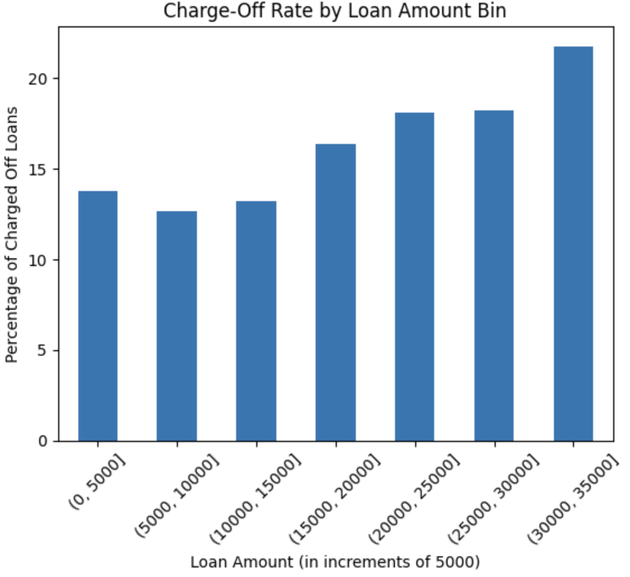
Loan Amount Distribution
- by Status
Loan Default rate
Vs Loan Amount
The maximum loan amount/per ticket is in the range of $5,000 - $10,000
Also the default in general increases proportional to the increase in Loan amount
Not strictly linear also not very significant to provide any recommendations

Slide 9
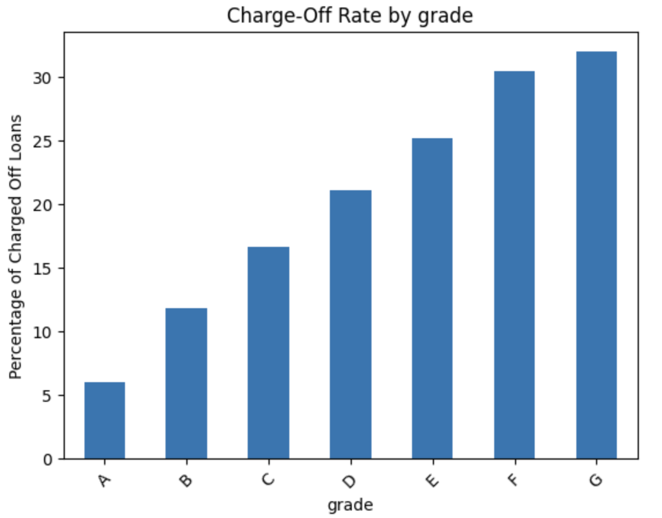
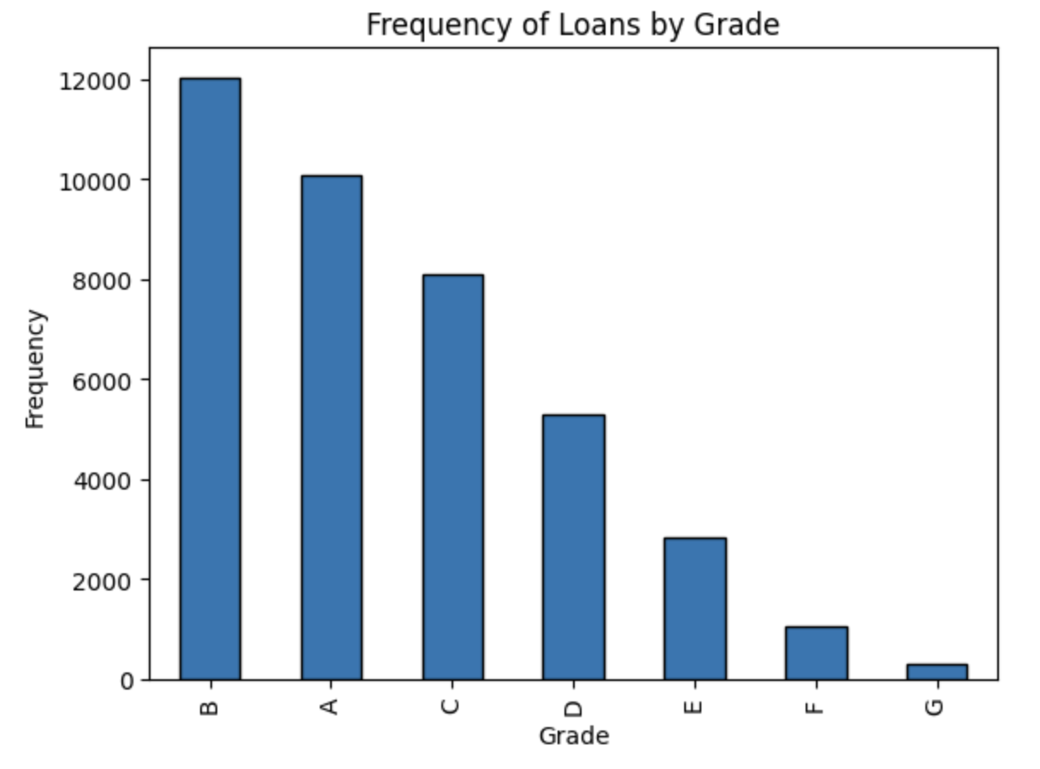
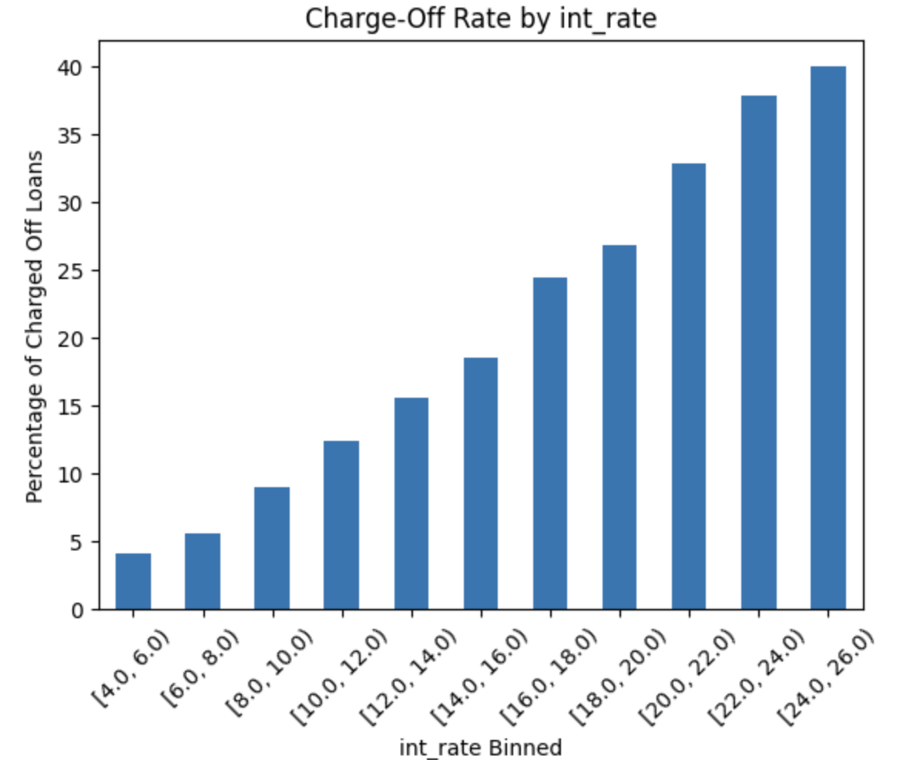
Default vs Grade Profile of
customers
Loan Disbursal against Grade
profile
Loan Default vs Interest rate
Strict linear corelation exists between Grade Profile and Loan default rate
Also there is similar corelation exists between Grade Profile and Loan disbursal
We also found (not captured here) direct corelation between Grade and Interest rate
So the risk is factored in by charging higher interest for lower Grade profiles
Already the co-relation is taken into account and no recommendation required

Slide 10
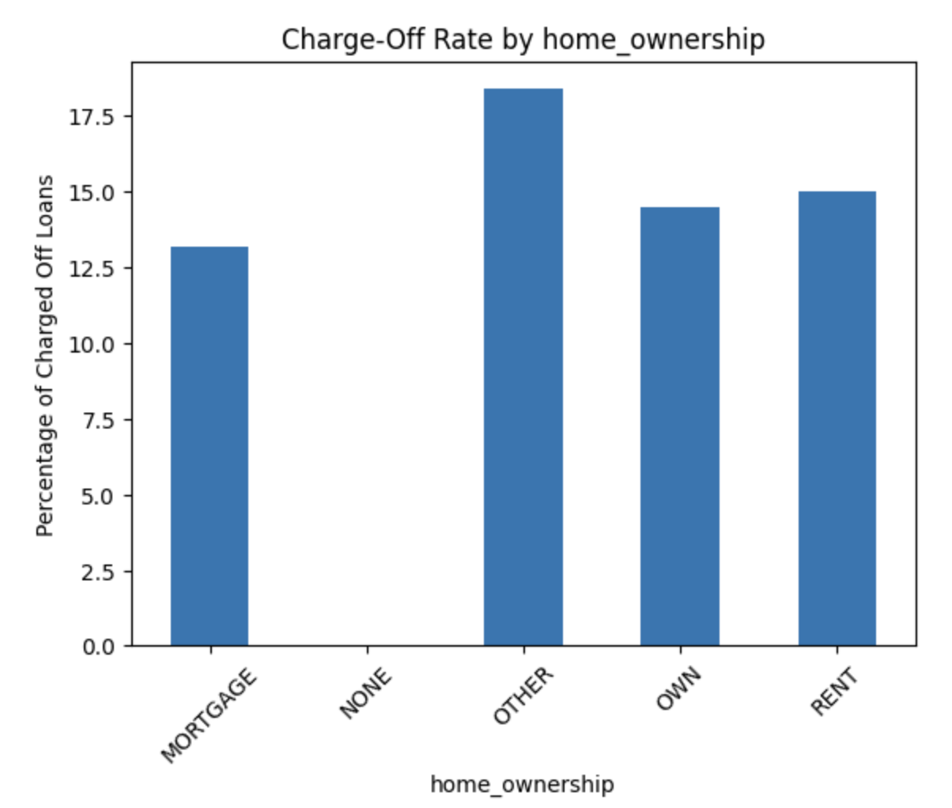
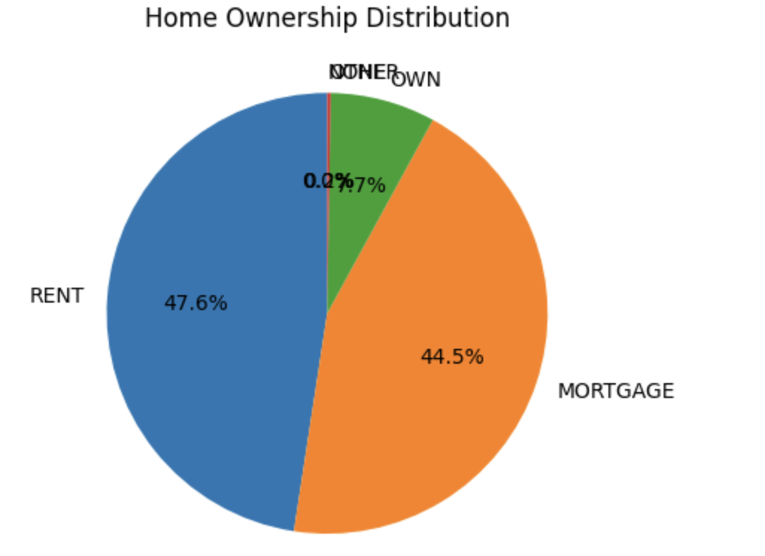
Default vs Home Ownership
Loan Disbursal against Home Ownership
Mortgage, Owning and Renting Home have similar default rates ( slightly increasing)
Other category of Home Ownership has elevated default rates
We can recommend to study further on the Other category of Home Ownership

Slide 11
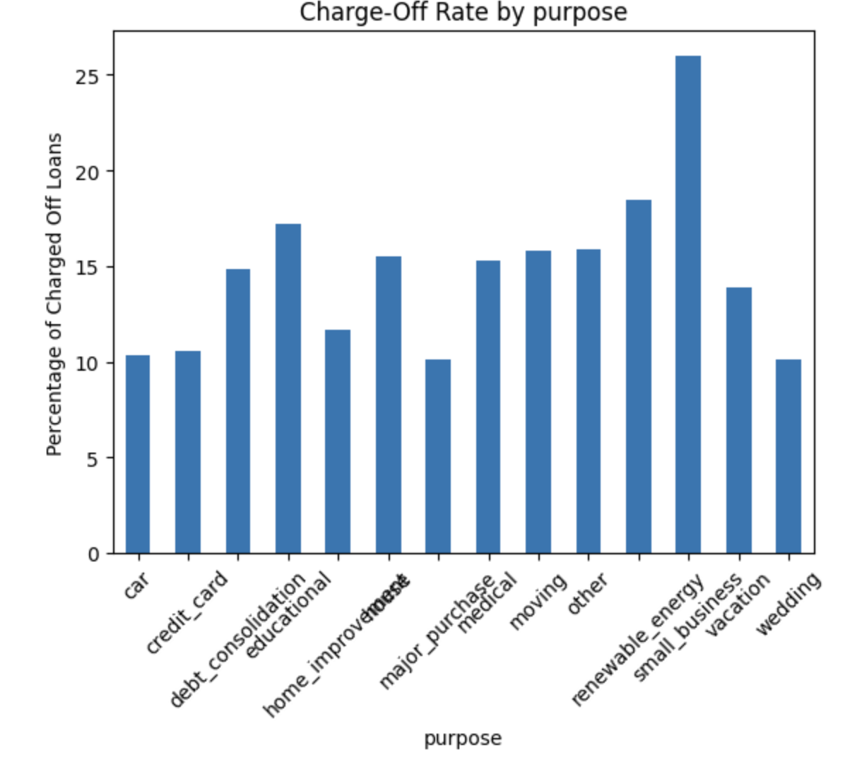
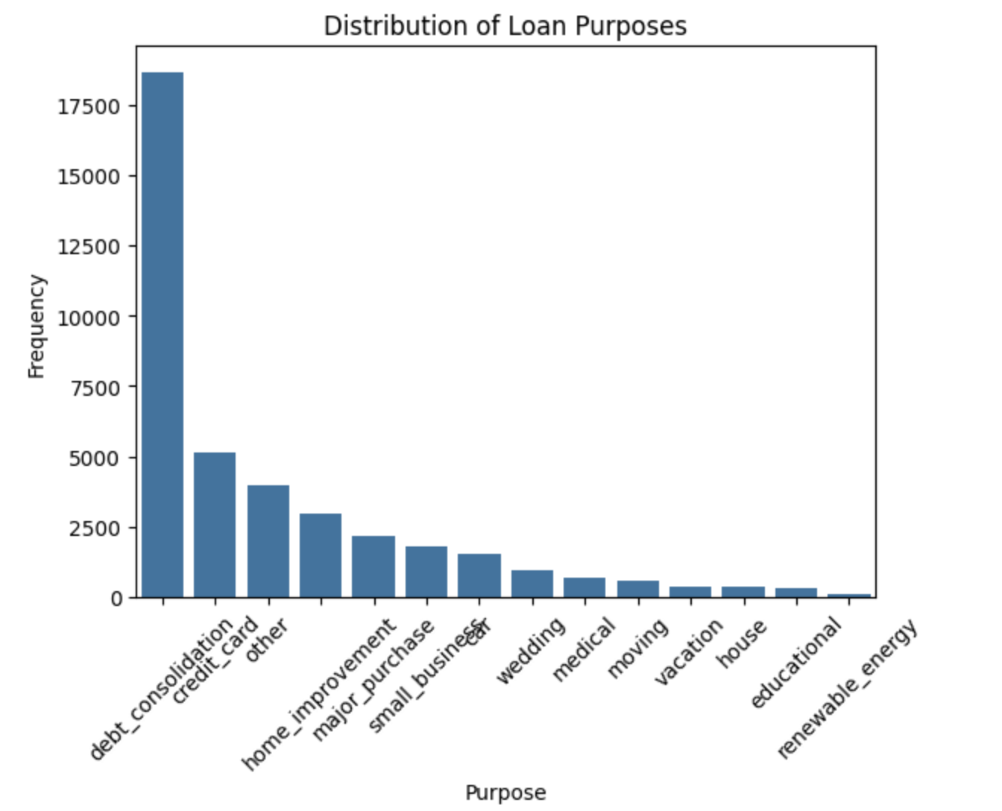
Default vs Loan Purpose
Loan Disbursal against Loan Purpose
Small business, Educational and Renewal Energy are riskier purposes for Loan disbursal
We can recommend to increase loan disbursal for wedding and home improvement

Slide 12
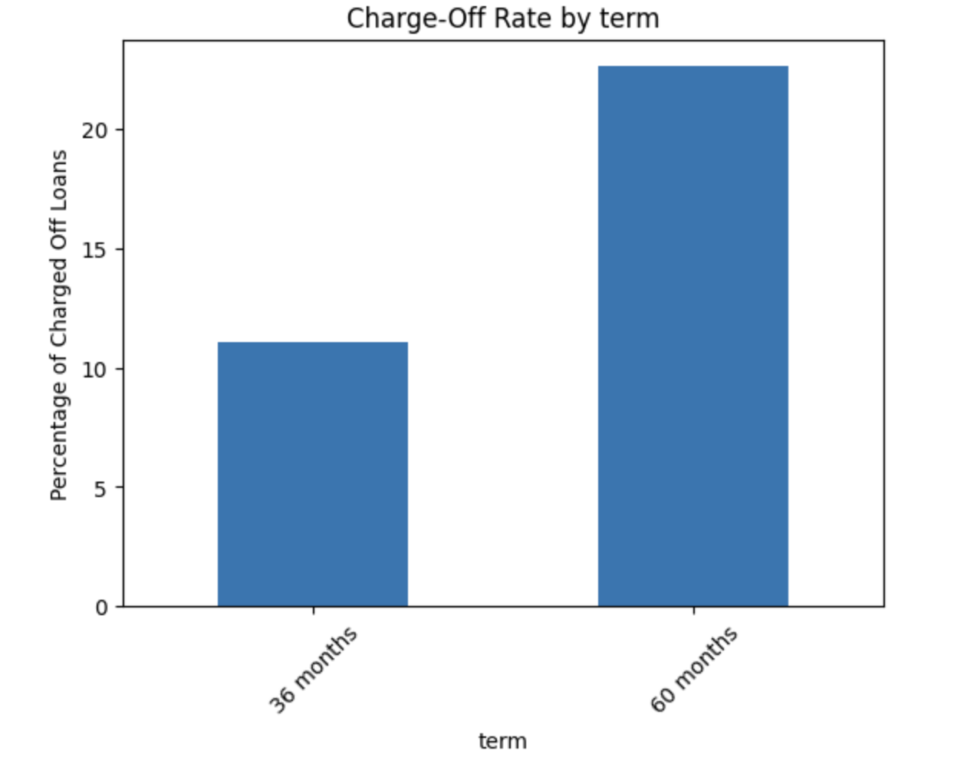
Strong relation between longer repayment term and defaulting
We can strongly observe higher default risk associated with longer repayment duration
Default vs Repayment Terms

Slide 13
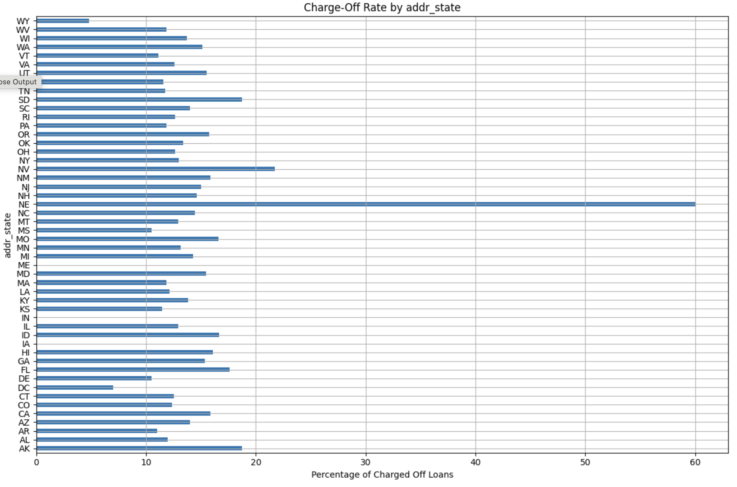
Nebraska has highly skewed default rate but has only 6 loan disbursals, so it can be considered an outlier
We observe the following states having relatively higher defaulting rates
SD: South Dakota AK: Alaska FL: Florida NV: Nevada
Default vs States in the US

Slide 14
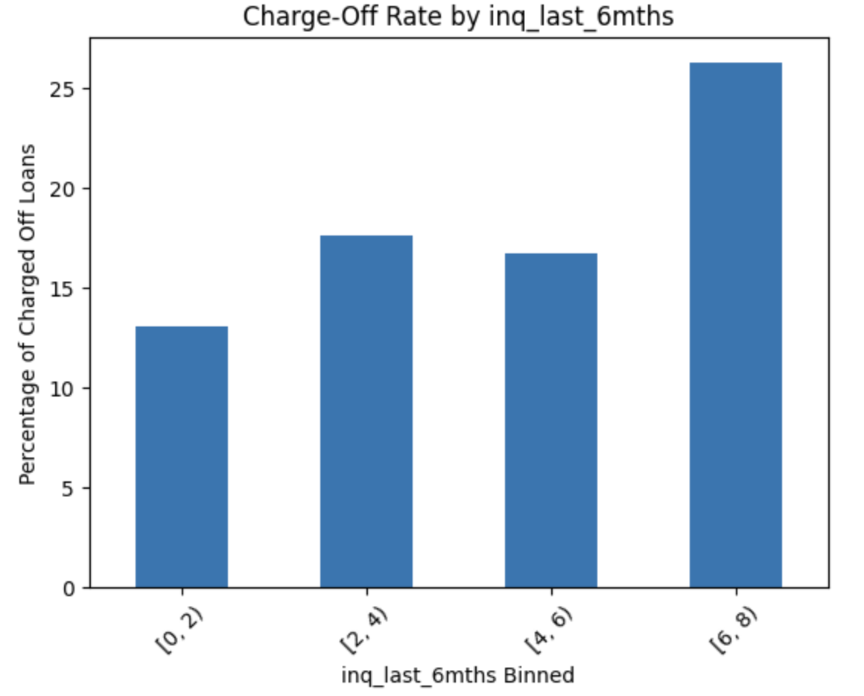
The higher the loan enquiries especially at the higher end of greater than 6 enquiries default rates is higher
Default vs Loan Enquiries

Slide 15
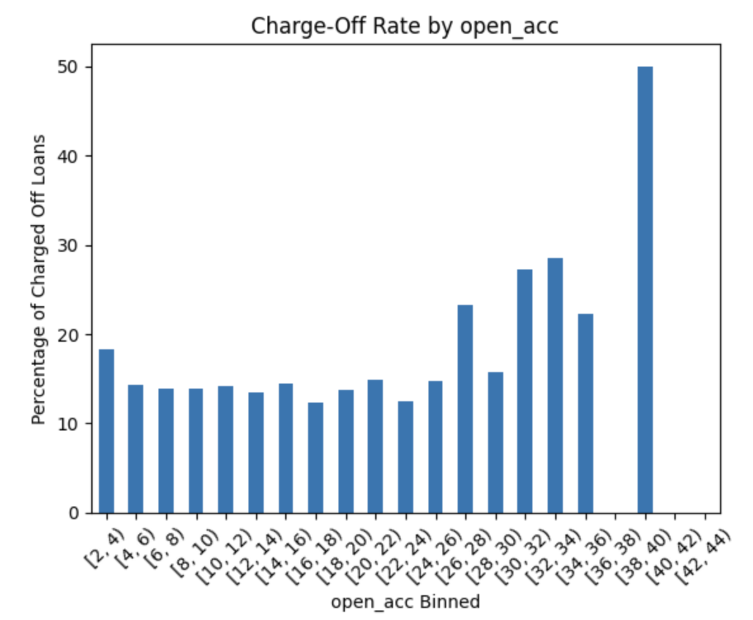
No strong correlations can be found against default considering the extreme values
But in context with other criteria we can use this insight
Default vs No. of Open Credit Lines

Slide 16
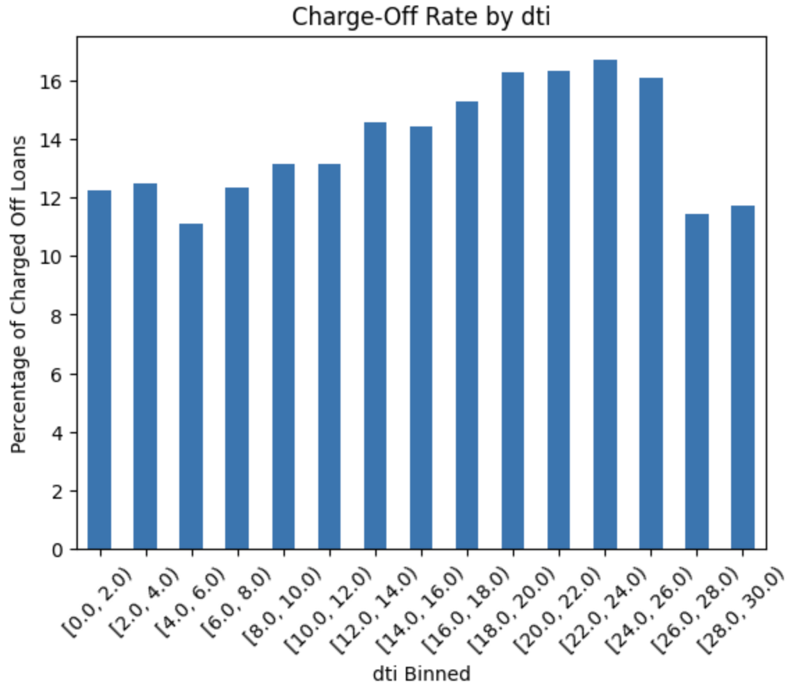
Leaving out the low and high extremes there is a linear correlation between Default rate and Ratio of Debt to Income
Default vs Ratio of Debt to Income

Slide 17
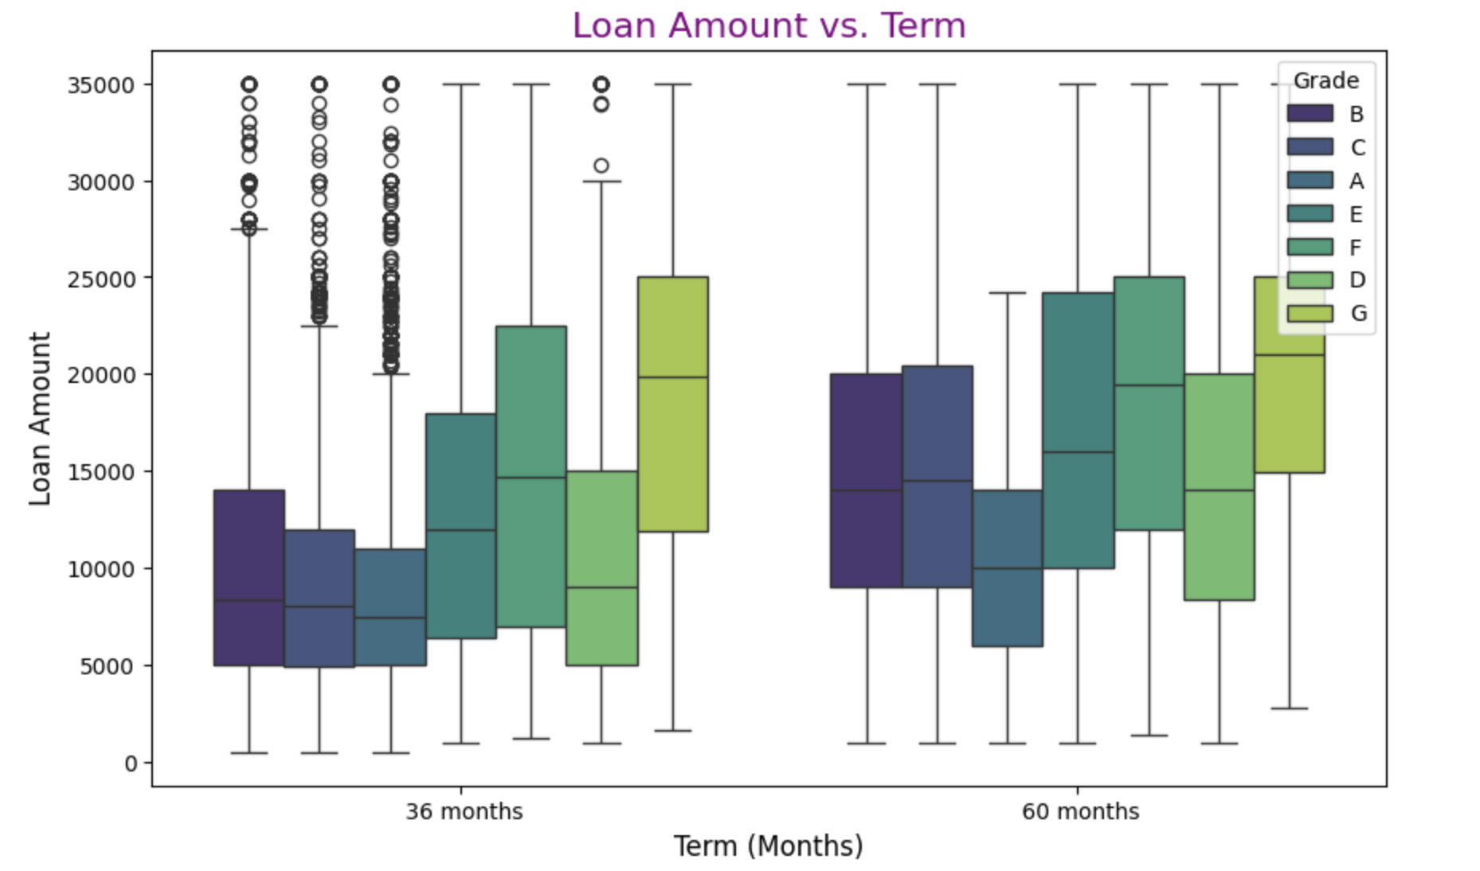
Loan Amount Vs Term
Loan-Related Parameters - Objective: Check if higher loan amounts are associated with longer terms (e.g., 60 months).
Strong association exists as postulated

Slide 18
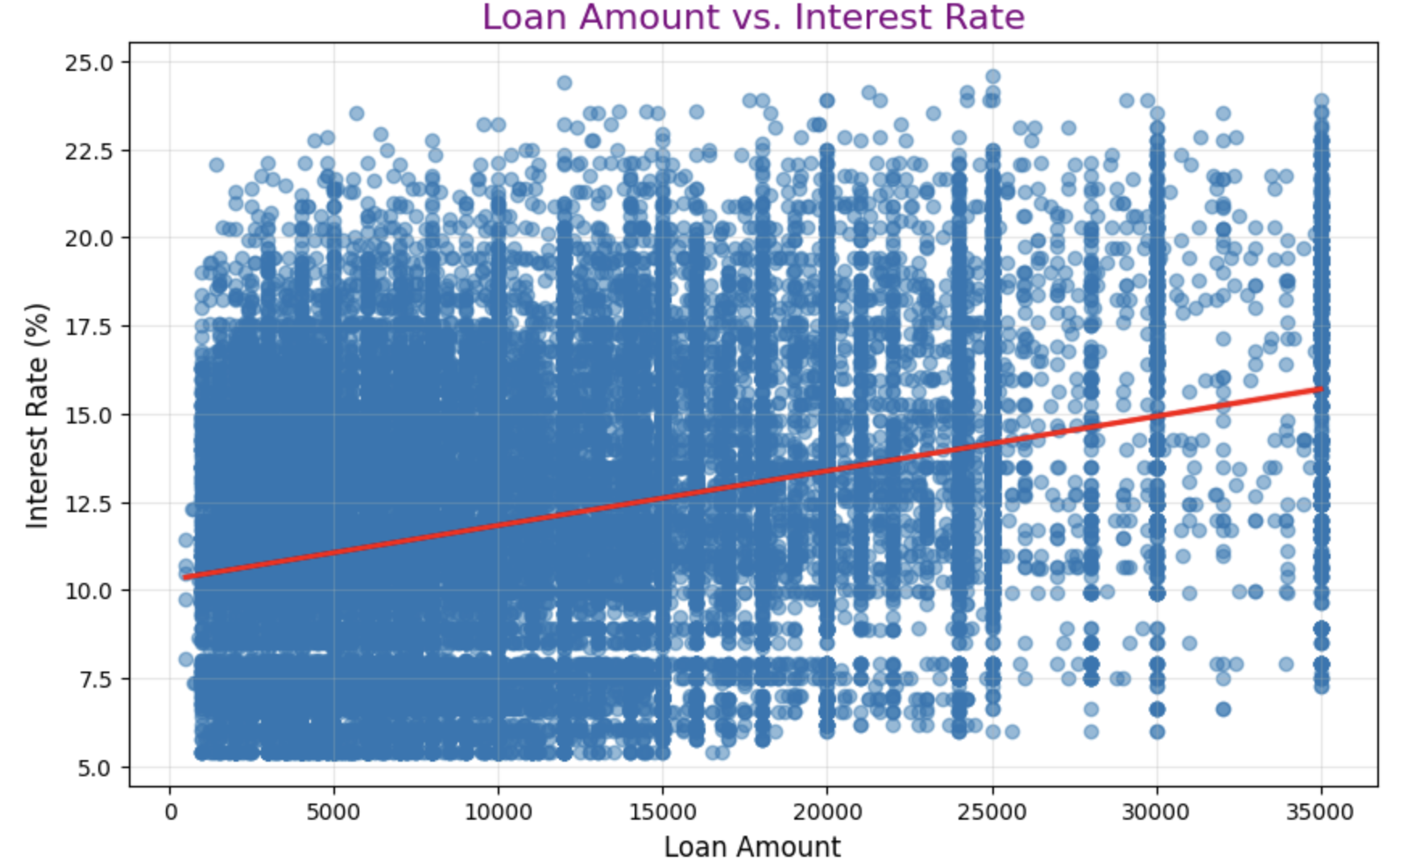
Loan Amount Vs Interest Rate
Loan-Related Parameters - Objective: to check whether higher loan amounts tend to have higher interest rates
Again as postulated Scatter plot with regression line indicates Strong association

Slide 19
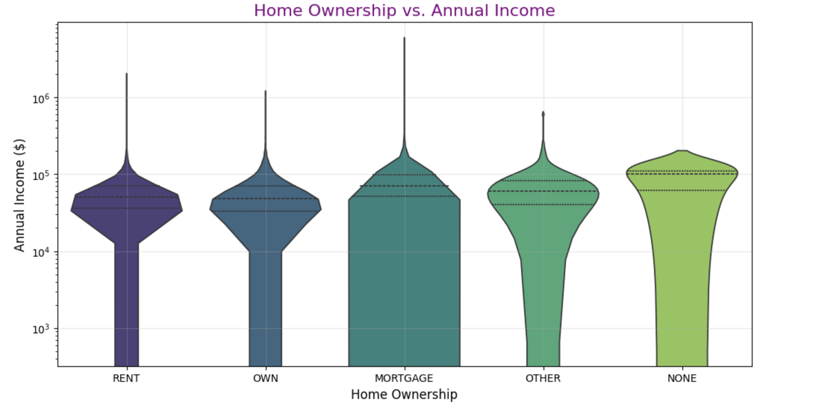
Home Ownership vs Annual Income
Borrower Demographics - Objective: to Objective: Compare the annual income levels across different home ownership statuses
Group violin plot does not indicate any significant associations

Slide 20
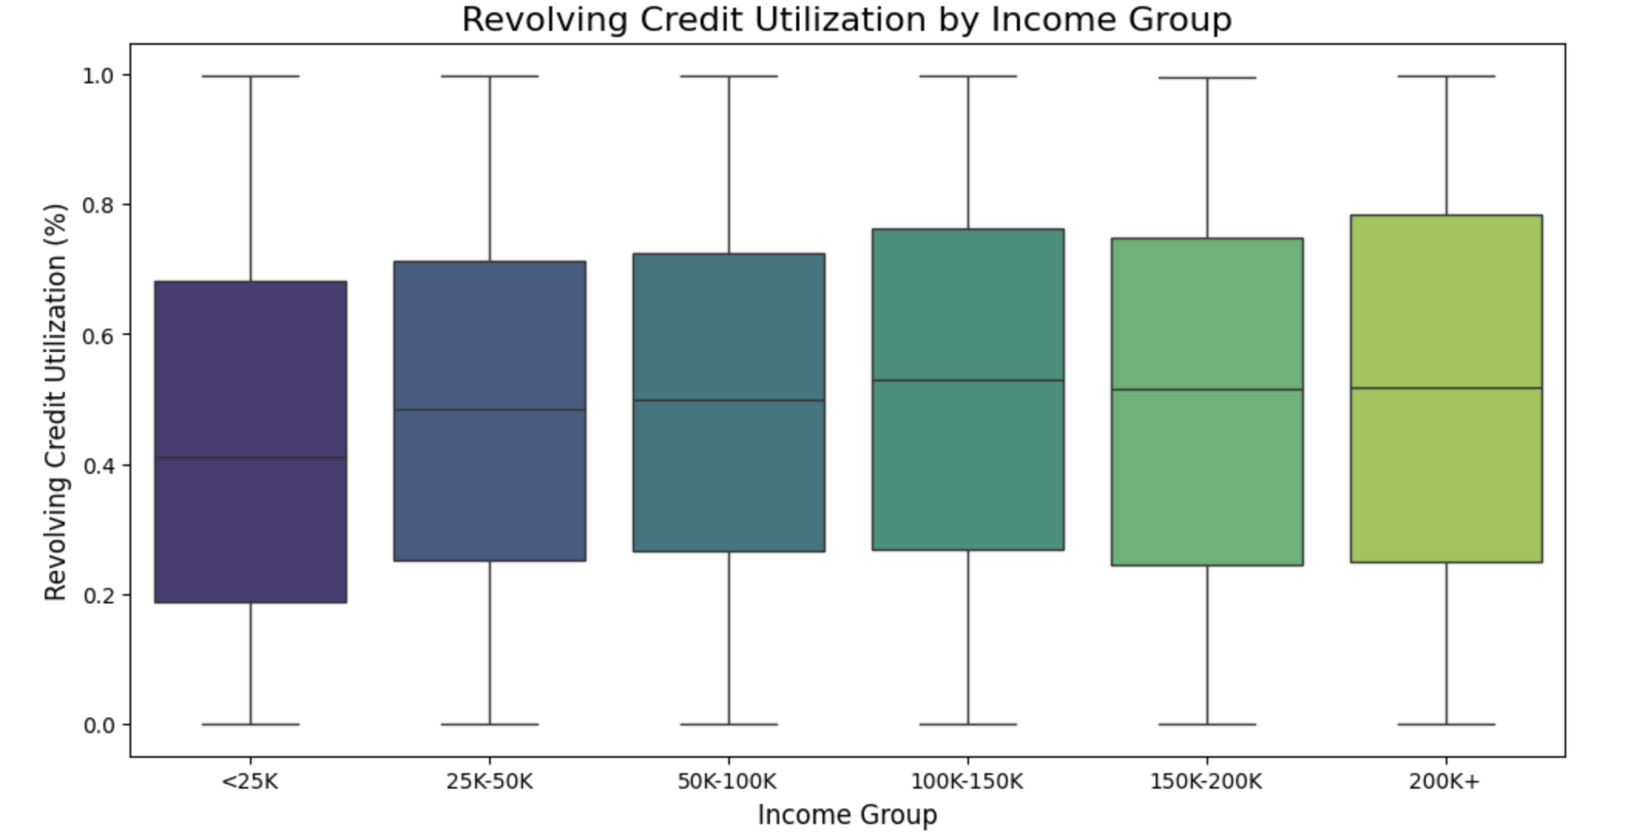
Revolving Credit Utilization by Income Group
Debt and Financial Behavior - Objective: To verify whether borrowers with higher income utilize less revolving credit.
Contrary to the postulate the high income group utilizes greater revolving credit

Slide 21
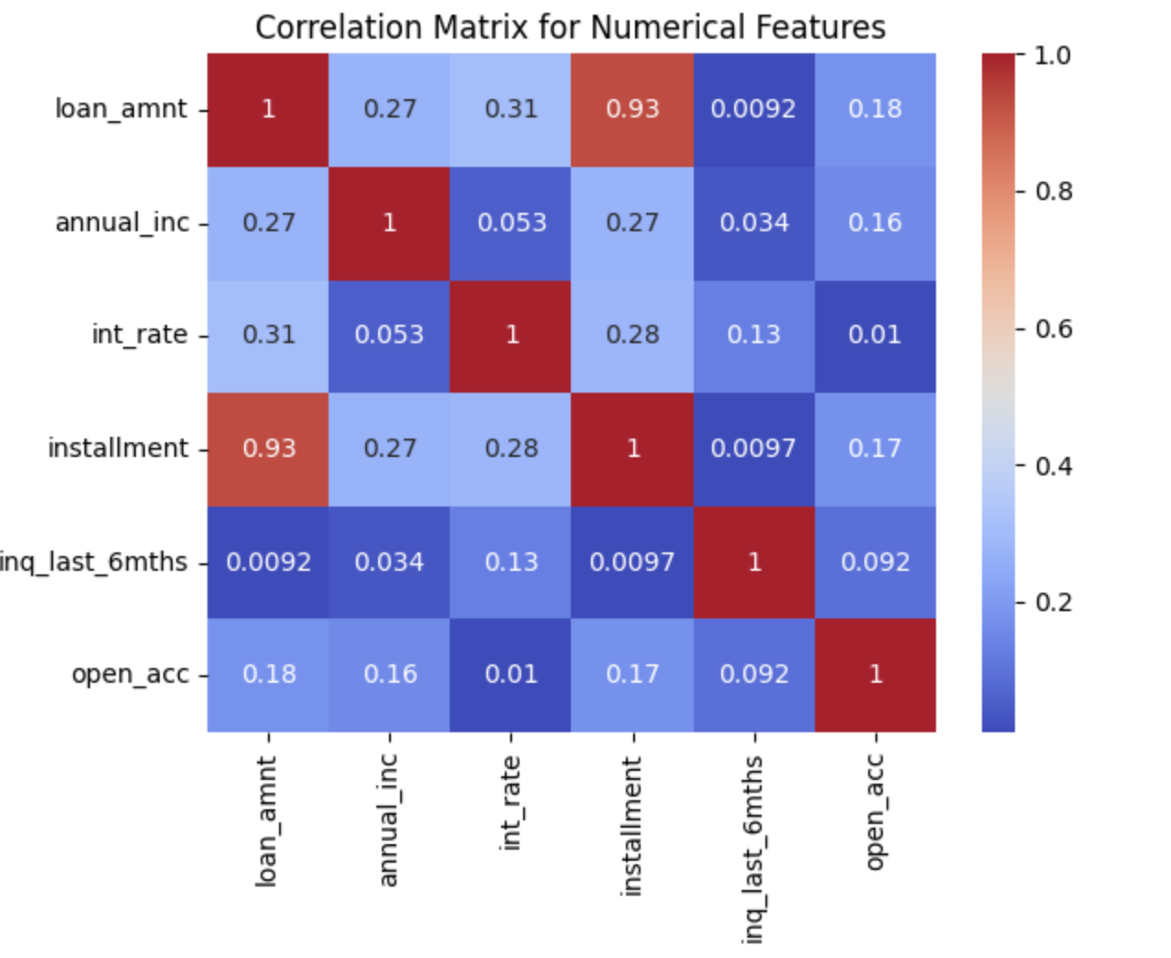
Higher the Loan amount naturally the repayment term will be longer but the default risk is also higher
We are also seeing a correlation existing between interest rate and installment duration, so the default risk is countered with higher interest rates
Correlation Matrix for Numerical Parameters

Slide 22
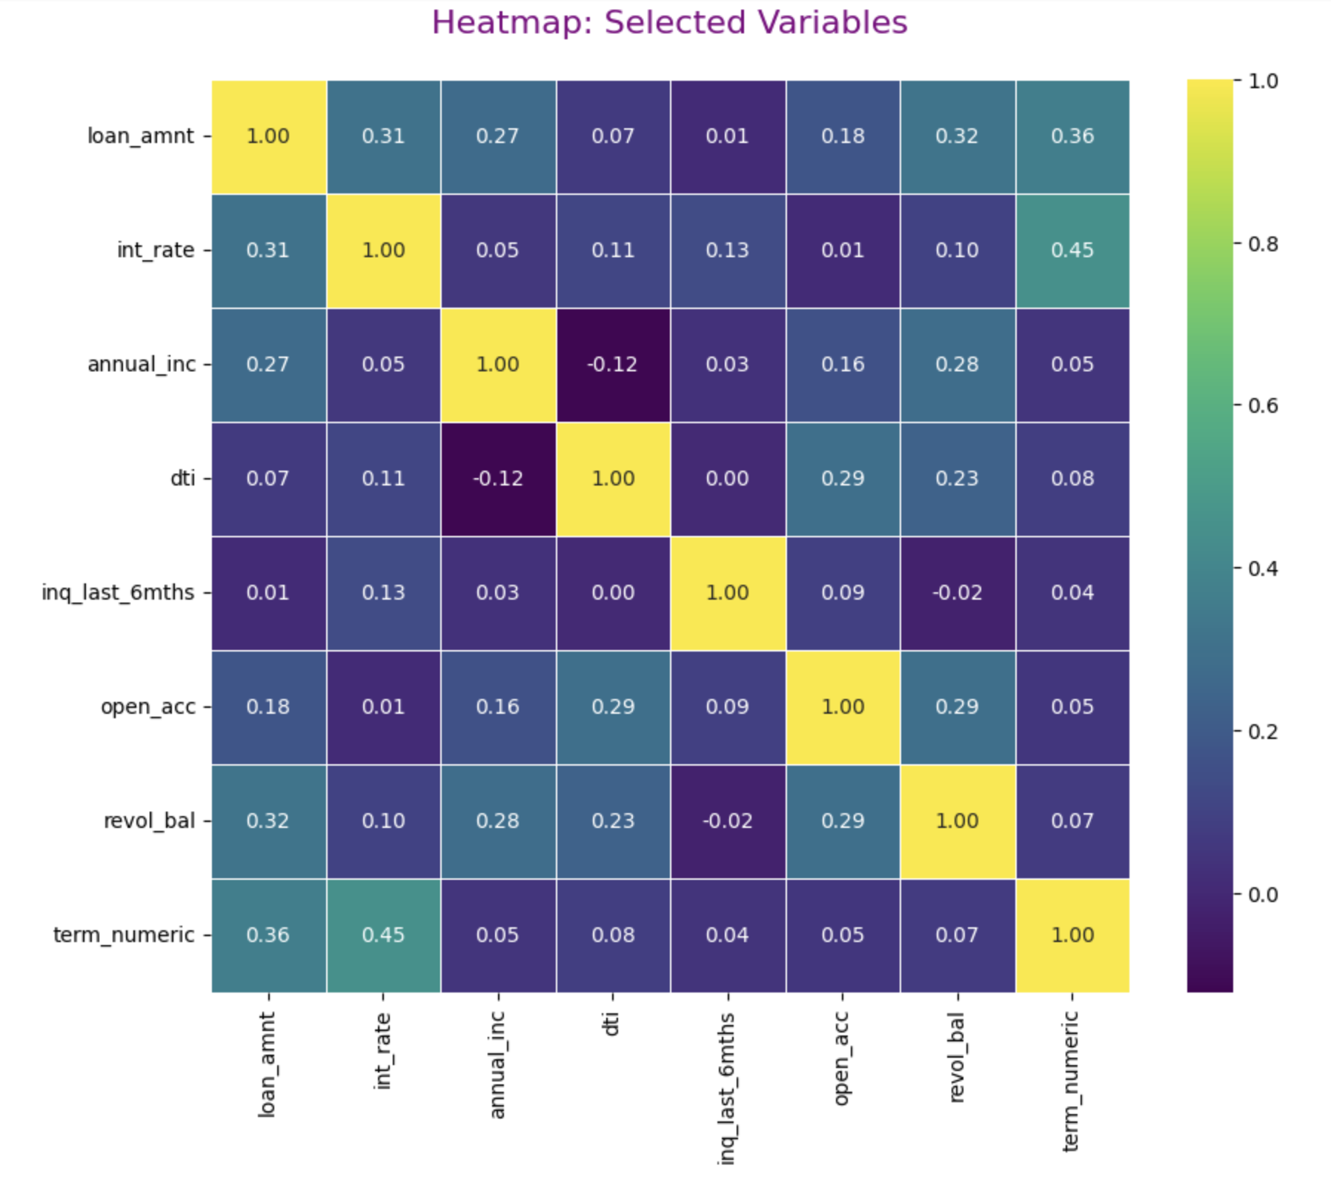
Strong relation between the following parameters
Interest rate and Term Duration
Debt to Income Ratio and No. of Open Credit Lines
Credit Revolving Balance and No. of Open Credit Lines
Debt to Income Ratio and Credit Revolving Balance
Observations
With higher interest rate loans we recommend approving shorter repayment term
Heat Map: Selected Variables
(loan_amnt, int_rate, annual_inc, dti, inq_last_6mths, open_acc, revol_bal, term)

Slide 23
Summary/Findings
Small business, Educational and Renewal Energy are riskier purposes for Loan disbursal
We can recommend to increase loan disbursal for wedding and home improvement
We can strongly observe higher default risk associated with longer repayment duration
We observe the following states having relatively higher defaulting rates
SD: South Dakota AK: Alaska FL: Florida NV: Nevada
The higher the loan enquiries especially at the higher end of greater than 6 enquiries default rates is higher
Leaving out the low and high extremes there is a linear correlation between Default rate and Ratio of Debt to Income
Using Bivariate Analysis certain postulates are checked for:
Higher loan amounts are associated with longer terms (e.g., 60 months), strong association exists as postulated
Higher loan amounts tend to have higher interest rates, strong association exists as postulated
Borrowers with higher income utilize less revolving credit, contrary to the postulate the high income group utilizes greater revolving credit
Correlation exists between interest rate and instalment duration, so the default risk is countered with higher interest rates
With higher interest rate loans we recommend approving shorter repayment term

